Slide 1
TravelPH
Bacong, Angel Kay R.
Cabadonga, Mesrelle
Deguzman, Eljan
Uba, Sharmanne Ace A.
Yusop, Warisa N.

Slide 2
TravelPH aimed to showcase the diverse and captivating tourist destinations scattered across the Philippines. This serves as a testament to the rich to the rich cultural heritage and natural wonders that make the Philippines a top choice for travelers worldwide.

Slide 3
Objectives: 1. Select 3 destinations for each categories representing variety of tourist attractions in the Philippines. 2. Develop informative descriptions and compelling visuals for each destinations. 3. Promote tourism in the Philippines by showcasing its natural beauty, cultural heritage, and urban attractions to a global audience.

Slide 4
Scope: 1. Creation of a website with different html for beaches, mountains, cultural sites and urban attraction. 2. Inclusion of three handpicked destinations for each category, accompanied by high quality pictures. 3. Development of detailed descriptions and additional information for each destinationon separate html pages.

Slide 5
Delimitation: 1. Due to time and resource constraints, only four categories with three destinations each will be included in the website. 2. The website will feature static content for each destination, focusing descriptions, and images without interactive elements such as user reviews or booking functionality. 3. While user can click on destination images to access detailed descriptions, the website will not include advanced interactive features such as maps or virtual tour. 4. The project will focus primarily on frontend development, it wont feature backend functionality such as form submission or data storage.

Slide 6
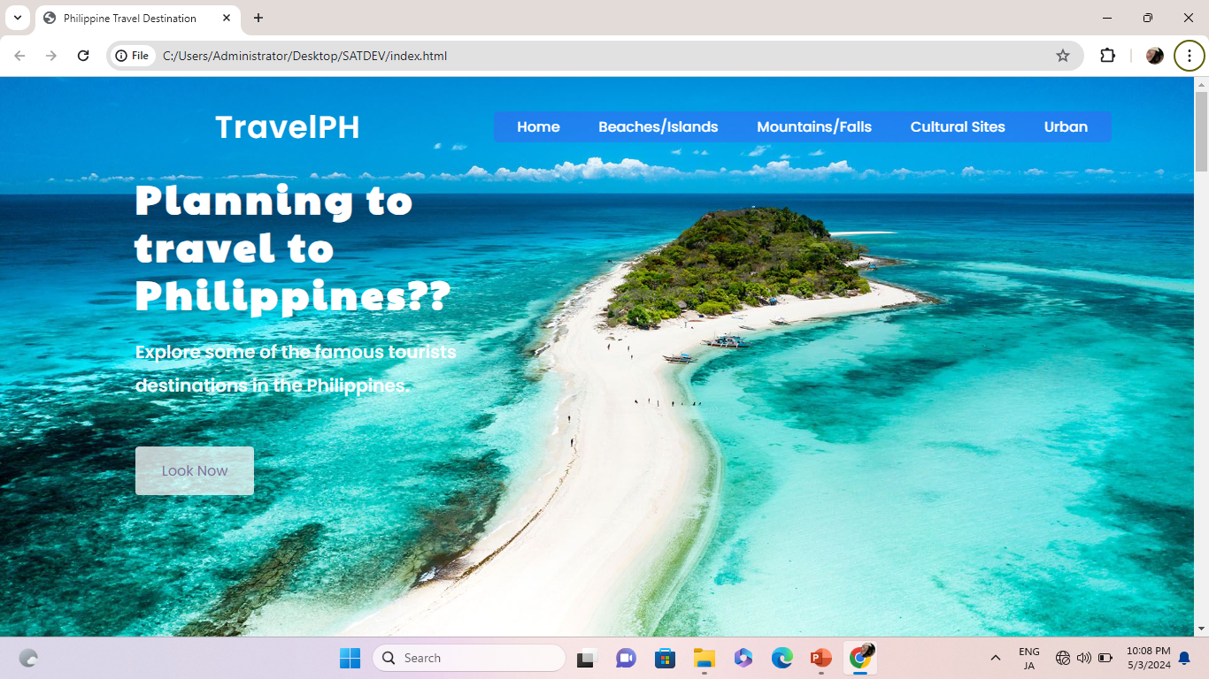
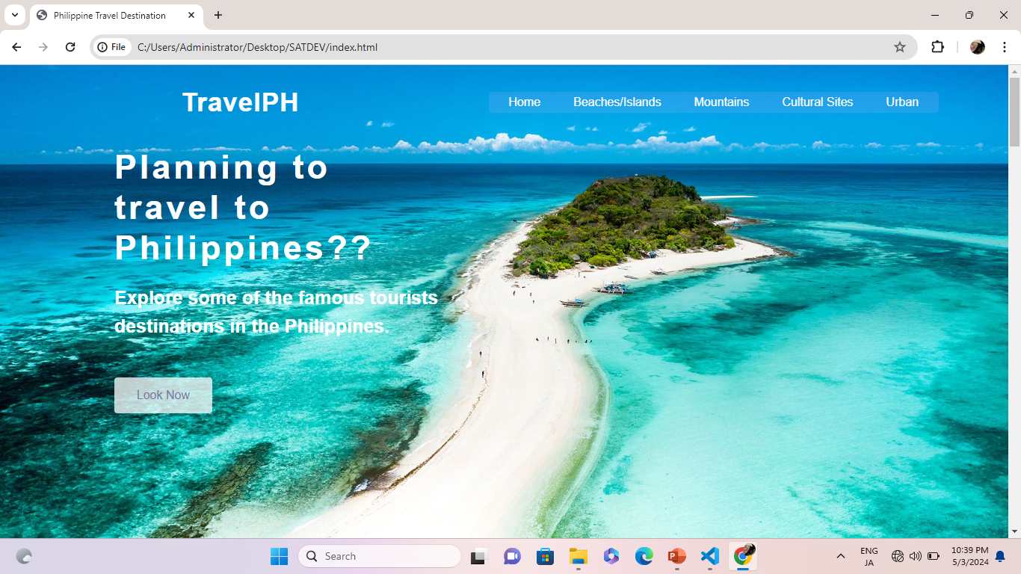

Slide 7
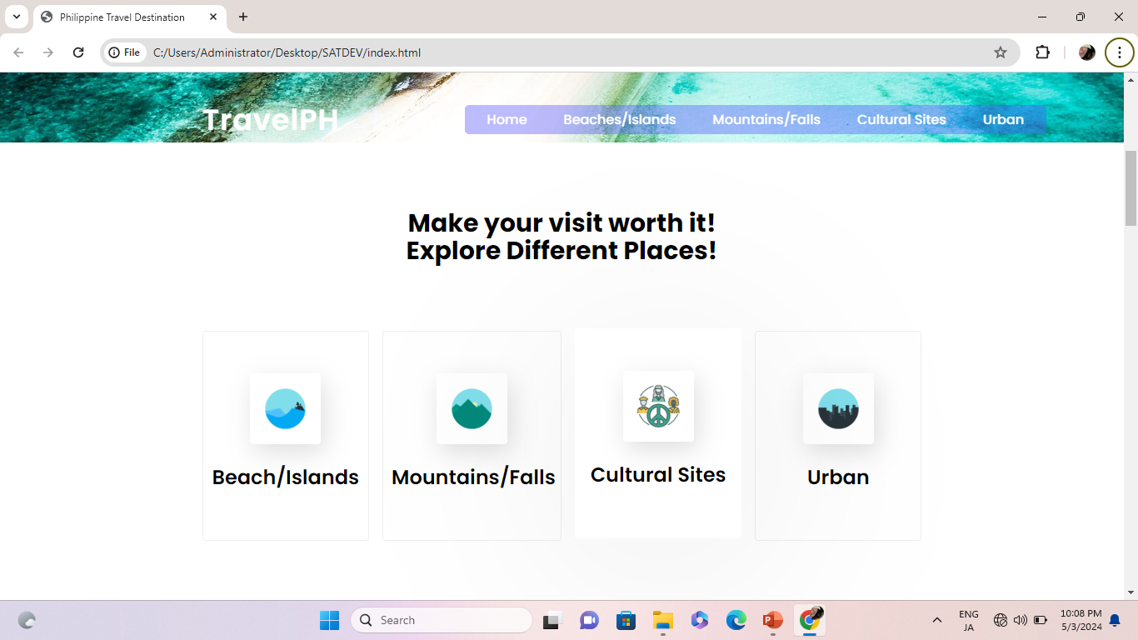
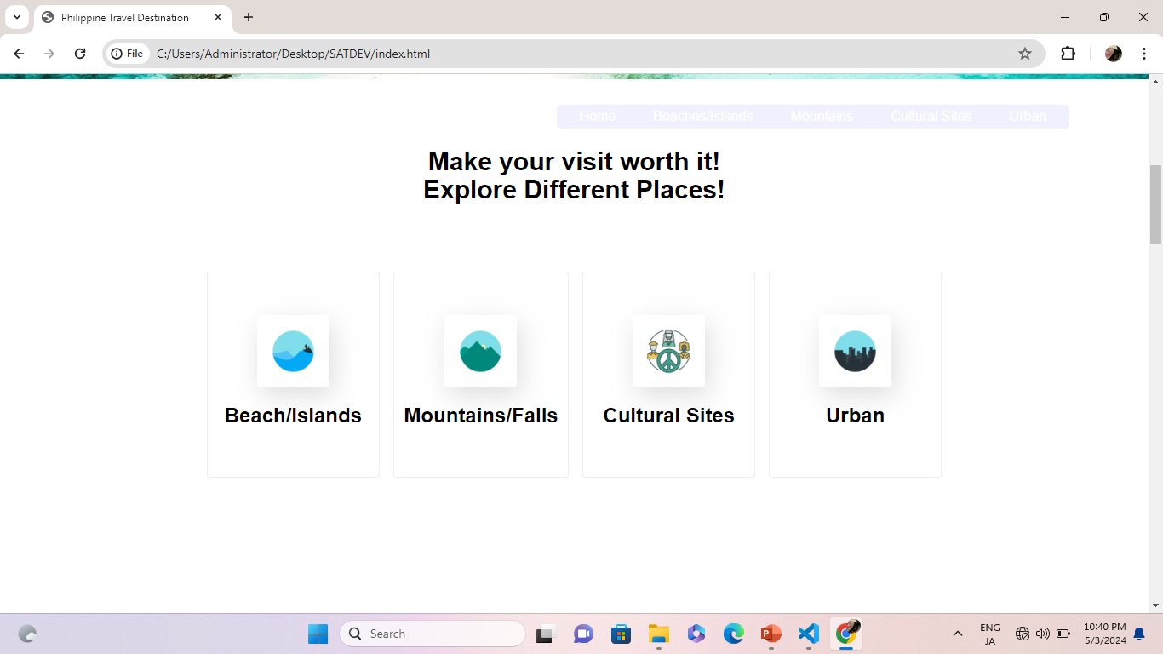
Table of contents
01
Section
02
Section
You can describe the topic of the section here
You can describe the topic of the section here
03
Section
04
Section
You can describe the topic of the section here
You can describe the topic of the section here

Slide 8
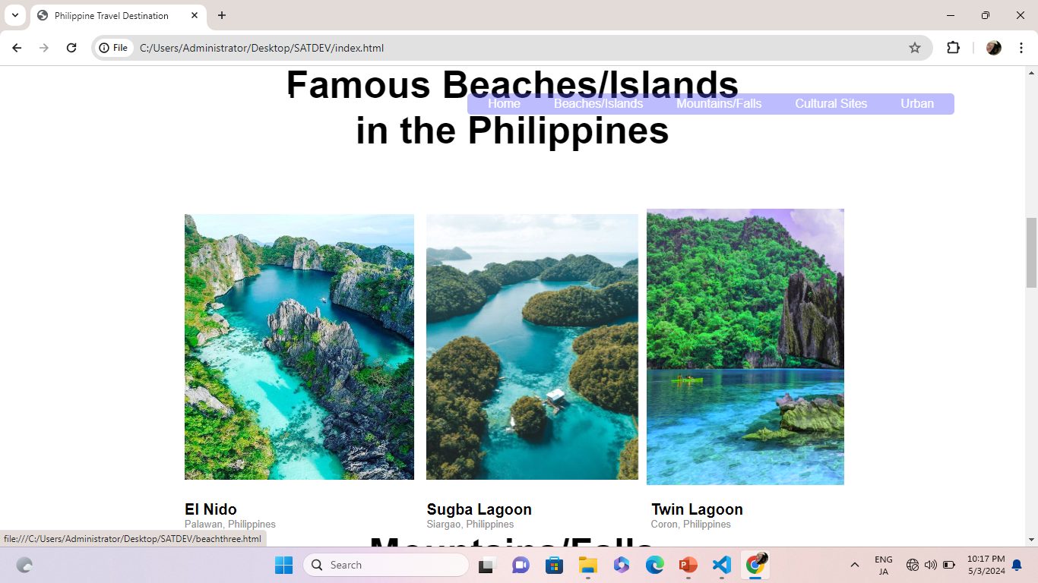
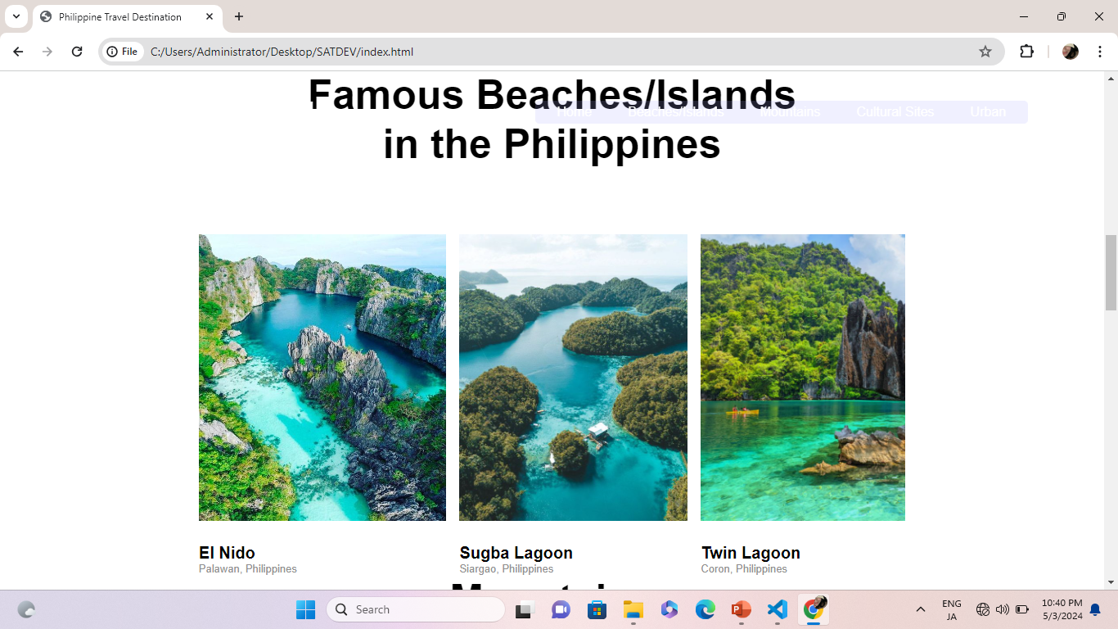
Name of the section
01
You can enter a subtitle here if you need it

Slide 9
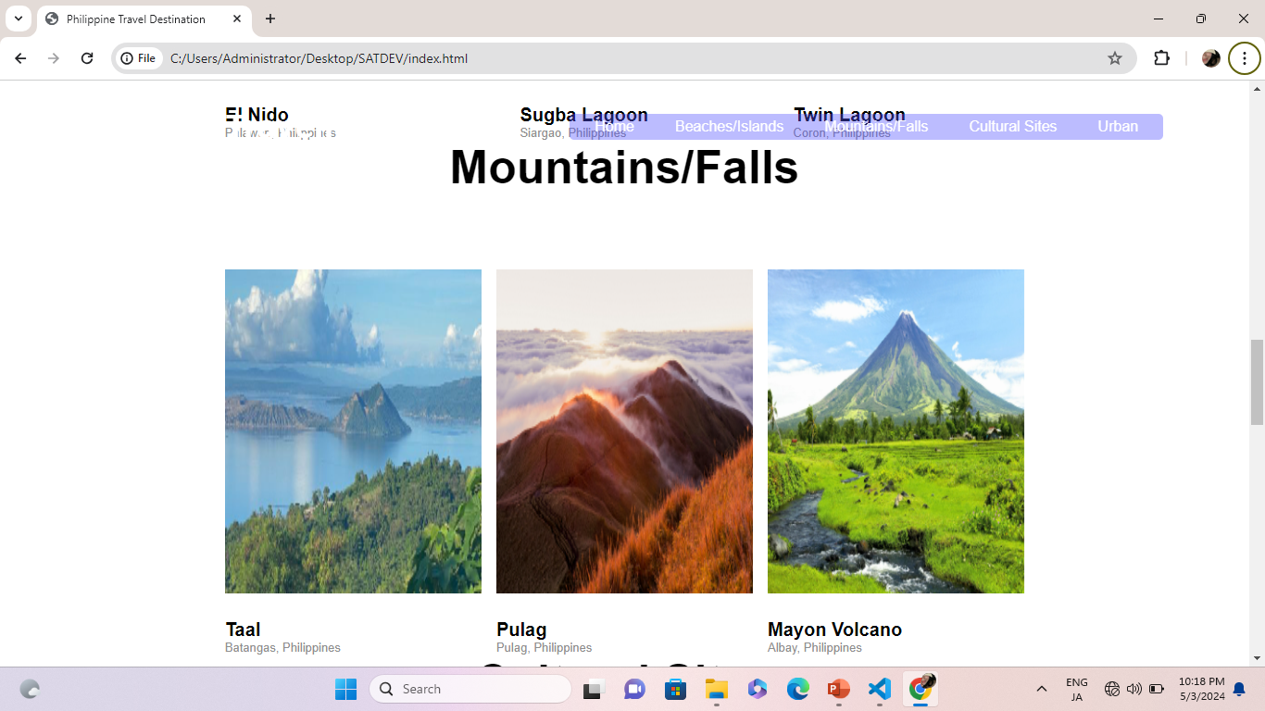
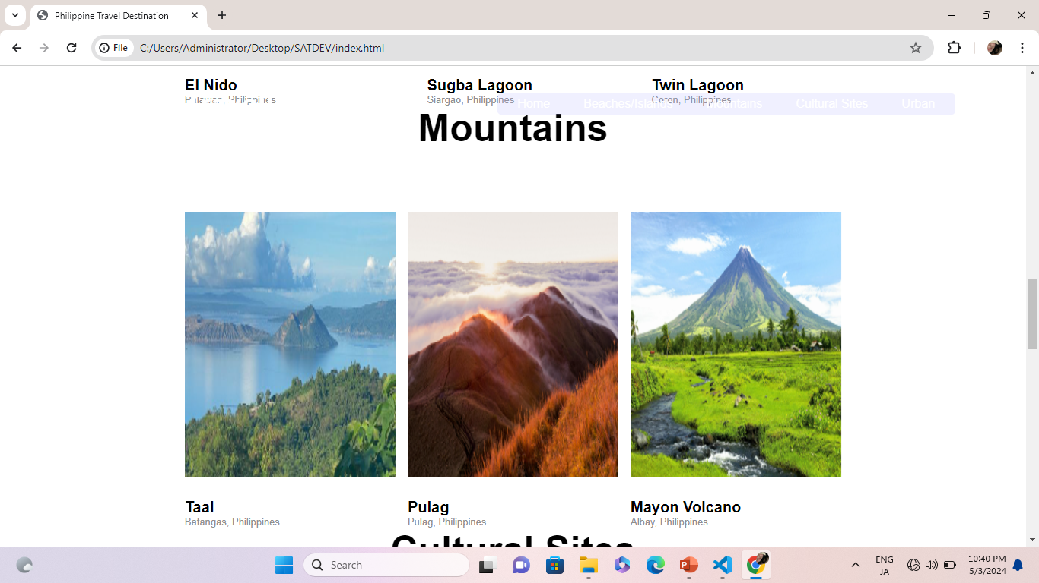

The slide title goes here!
Do you know what helps you make your point clear? Lists like this one:
They’re simple
You can organize your ideas clearly
You’ll never forget to buy milk!
And the most important thing: the audience won’t miss the point of your presentation

Slide 10
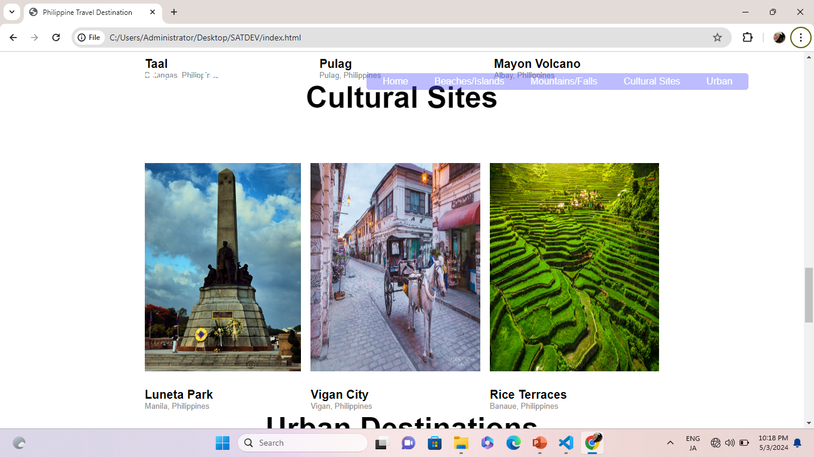
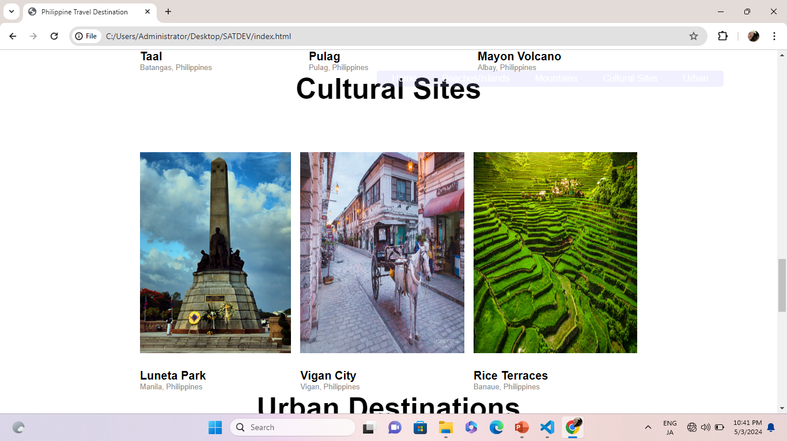
Two concepts
Mercury
Venus
Mercury is the closest planet to the Sun and the smallest one in the Solar System-it’s only a bit larger than the Moon
Venus has a beautiful name and is the second planet from the Sun. It’s very hot and has a poisonous atmosphere

Slide 11
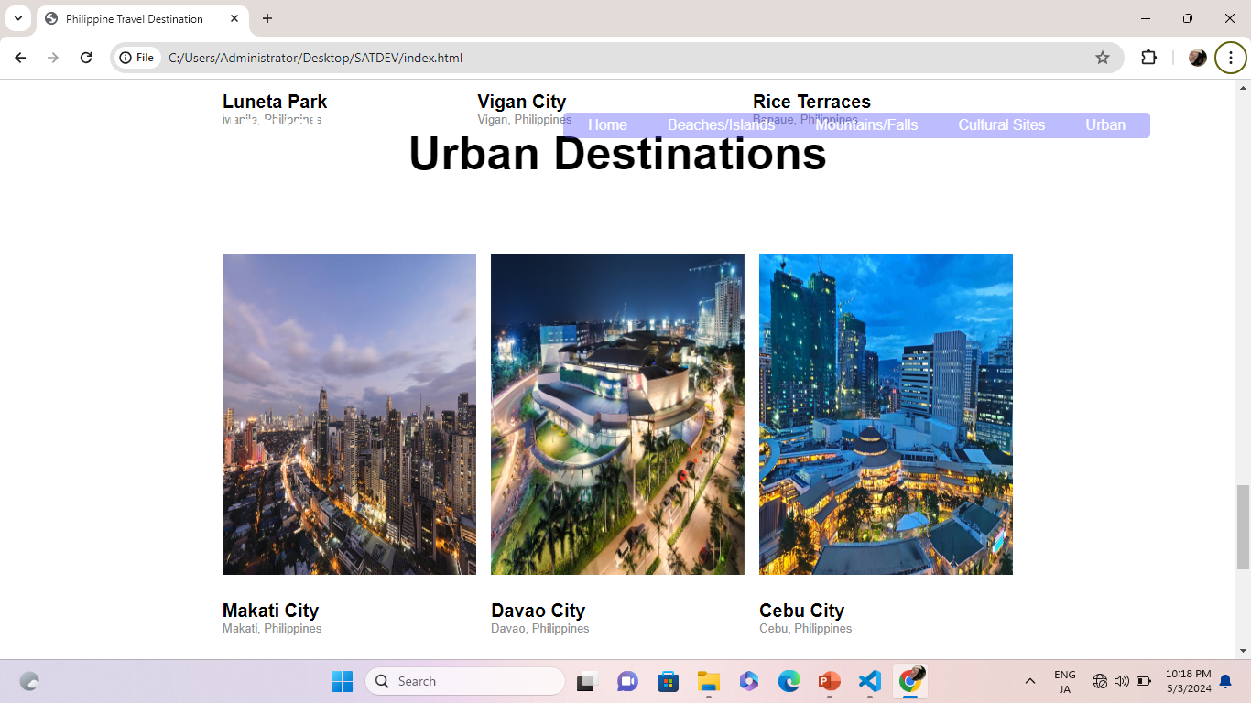
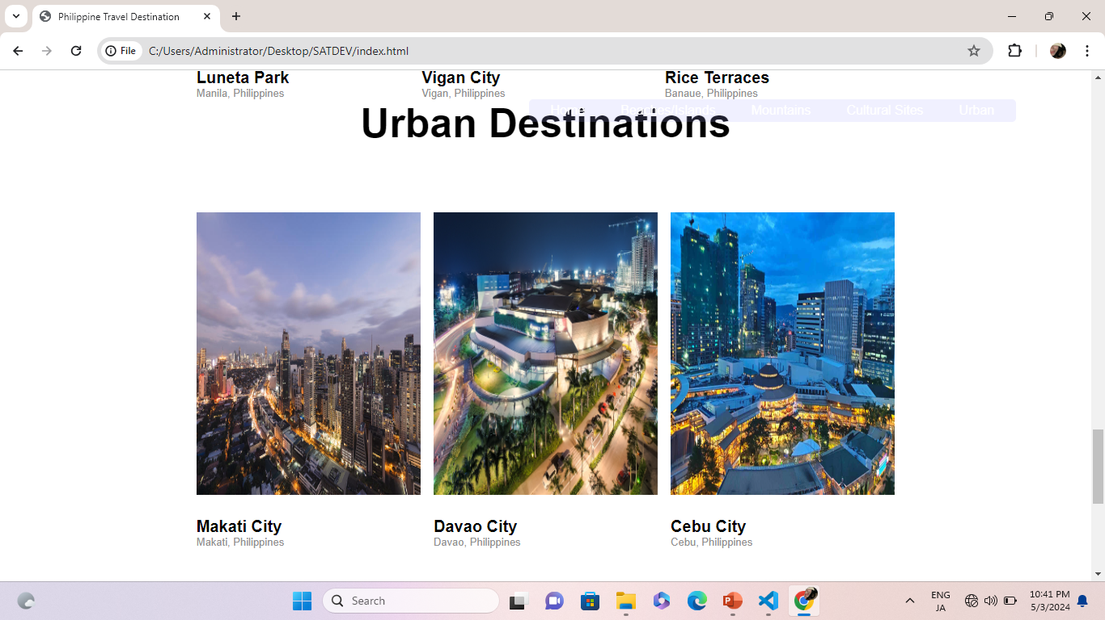
Three columns
Mercury
Venus
Mars
It’s the closest planet to the Sun and the smallest in the Solar System
Venus has a beautiful name and is the second planet from the Sun
Despite being red, Mars is actually a cold place. It’s full of iron oxide dust

Slide 12
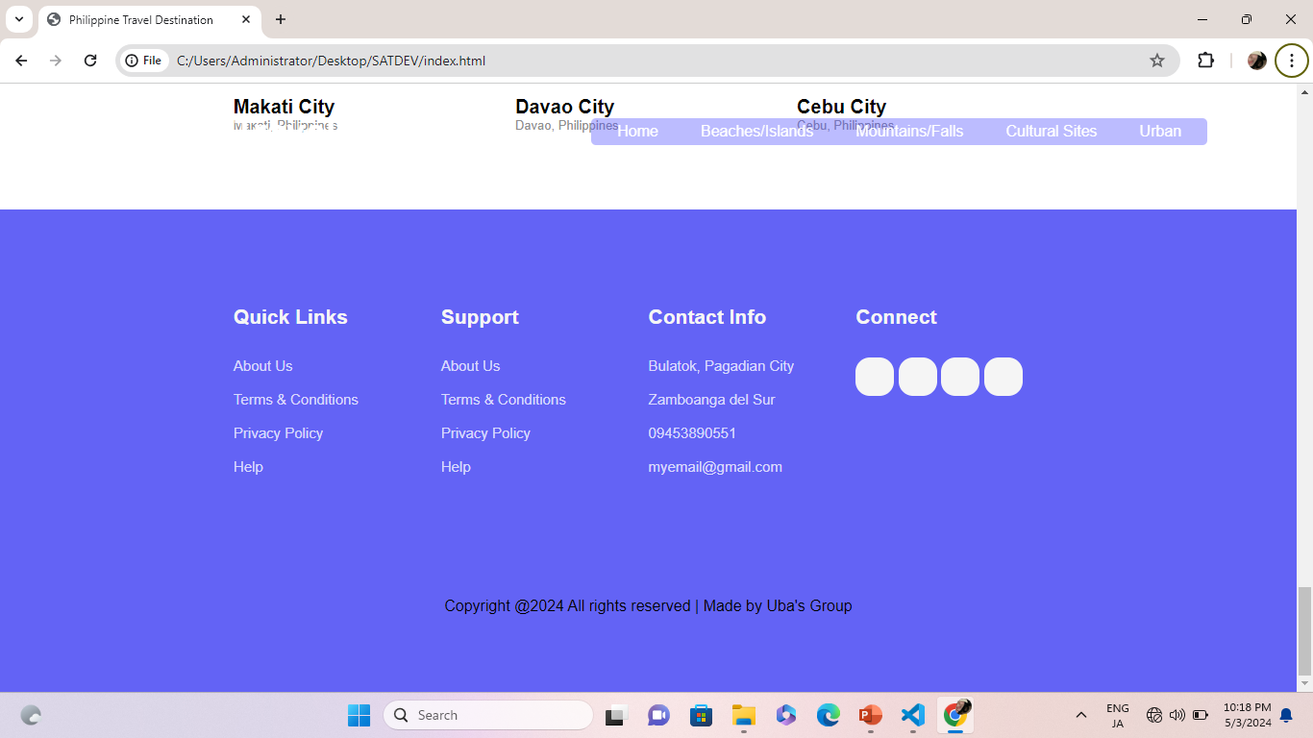
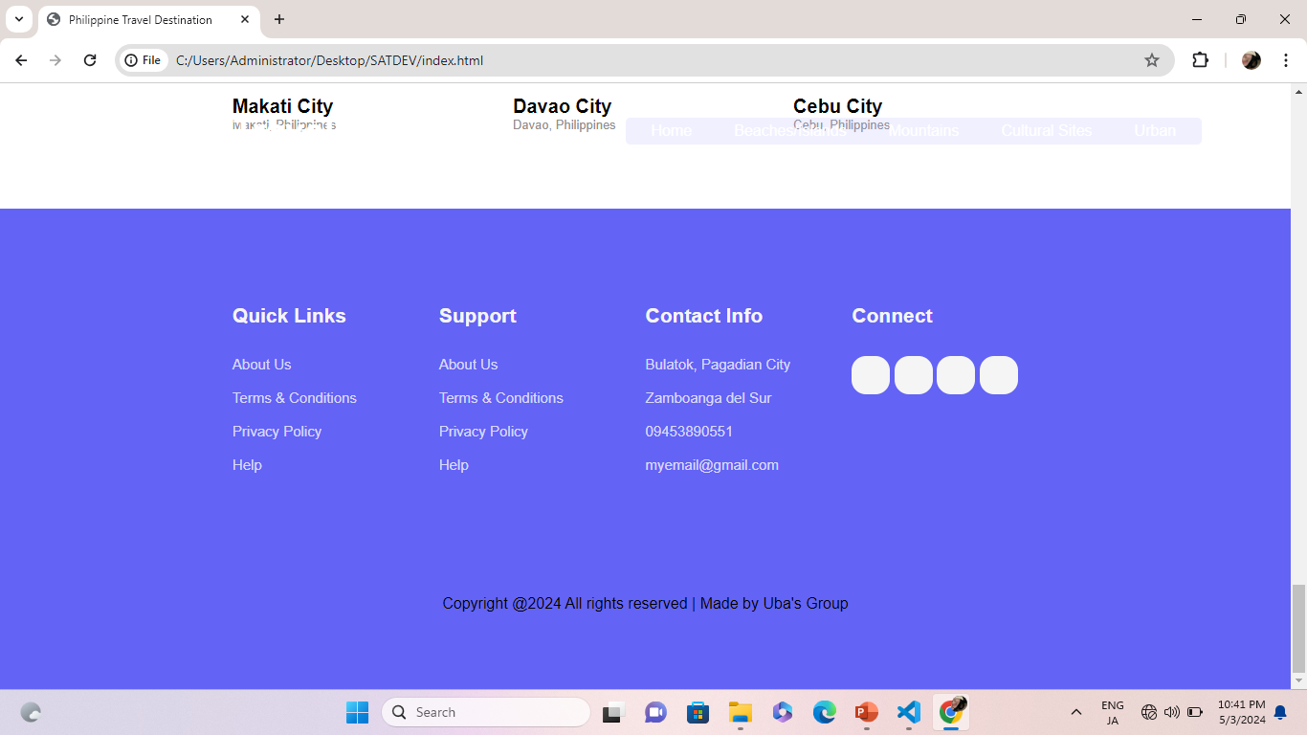

To reinforce the concept, try using an image
Images reveal large amounts of data, so remember: use an image instead of a long text. Your audience will appreciate it

Slide 13
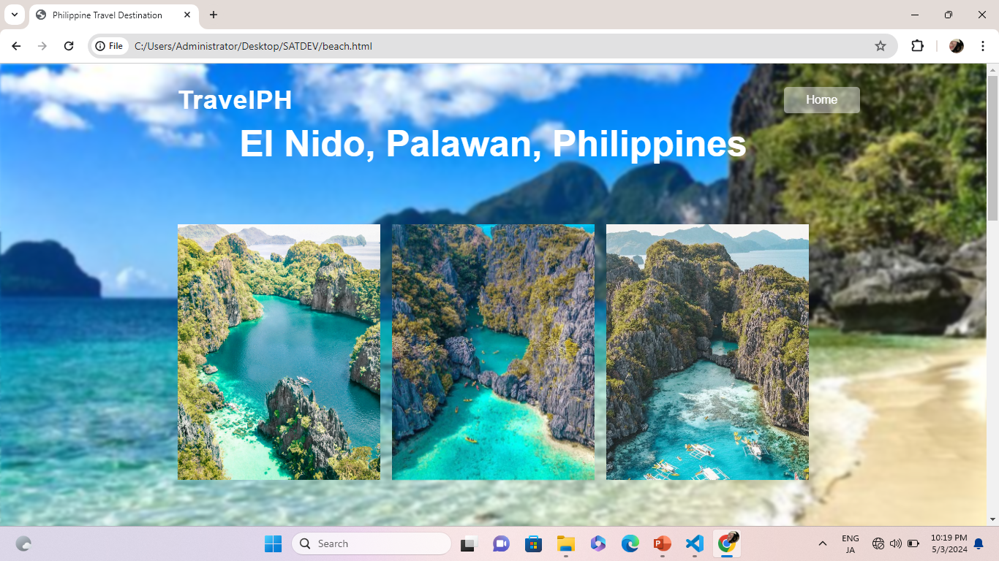
This is a map
Spain
Venus has a beautiful name, but it’s terribly hot
US
Mercury is the closest planet to the Sun
Australia
Despite being red, Mars is a cold place, not hot

Slide 14
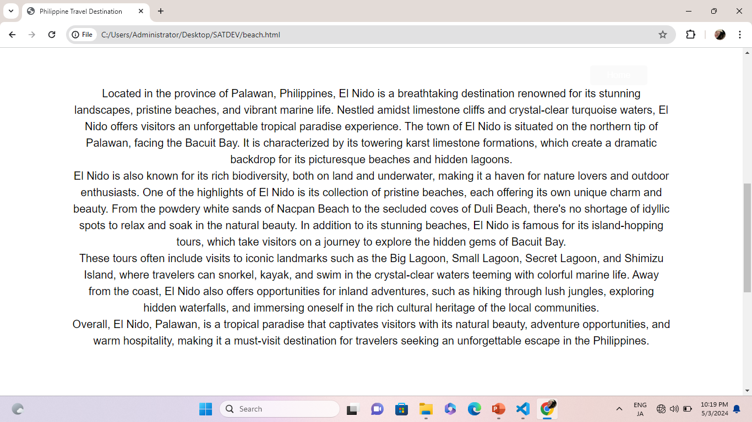
You can use this graph
Venus
It has a beautiful name, but it’s terribly hot
Mercury
Mercury is the closest planet to the Sun
Mars
Despite being red, Mars is a cold place, not hot
Follow the link in the graph to modify its data and then paste the new one here. For more info, click here

